Slide 1
Subsidized Housing Projects for Low-Income Households
Why We Don’t Offer Housing Assistance to All of the Poorest Families

Slide 2
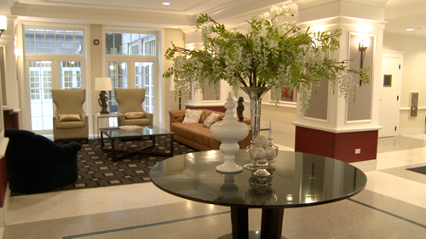
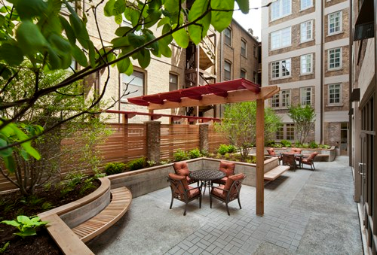
Senior subsidized housing in Chicago. “The Kenmore sits in Chicago's Uptown neighborhood and blocks from the lake and Asia on Argyle.” http://www.thecha.org/senior-housing/ DA: 8/6/2015

Slide 3
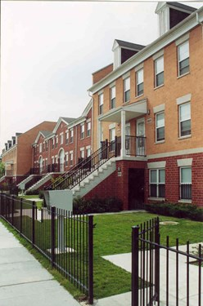
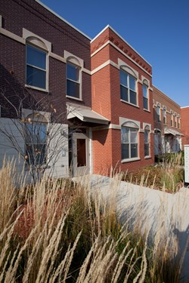
Mixed income housing in Chicago. “Westhaven Park is convenient to Malcolm X City College, the Loop and UIC.” http://www.thecha.org/mixed-income-housing/ DA: 8/6/2015
Mixed income housing in Chicago. “Legends South Hansberry Square. The units range from one to four bedrooms.” http://www.thecha.org/mixed-income-housing/ DA: 8/6/2015

Slide 4
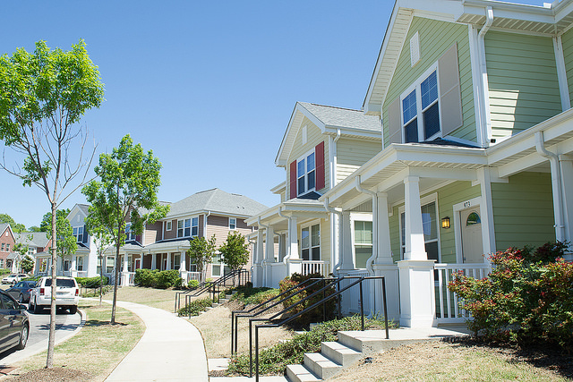
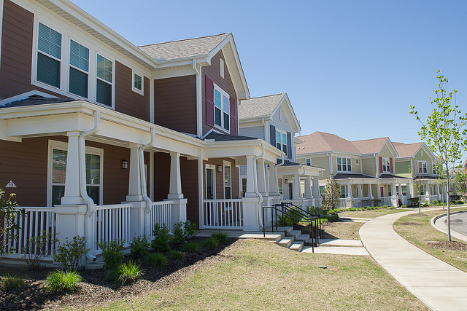
https://www.flickr.com/photos/hudopa/14041685976/
https://www.flickr.com/photos/hudopa/14065254234/
Legends Park in Memphis. “A mixed-income community that will eventually offer 405 apartment units, is semi-gated and has a community pool and gym.” http://www.commercialappeal.com/business/dot-by-dot DA: 8/6/2015

Slide 5
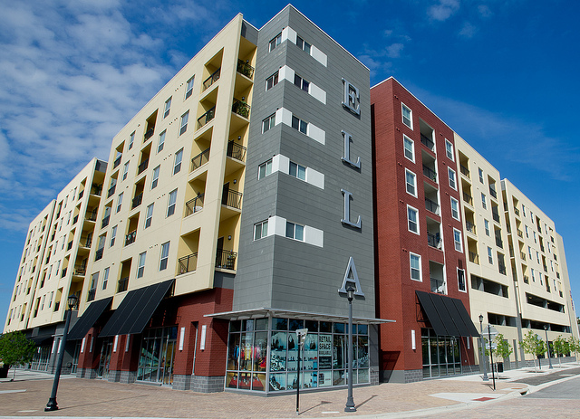
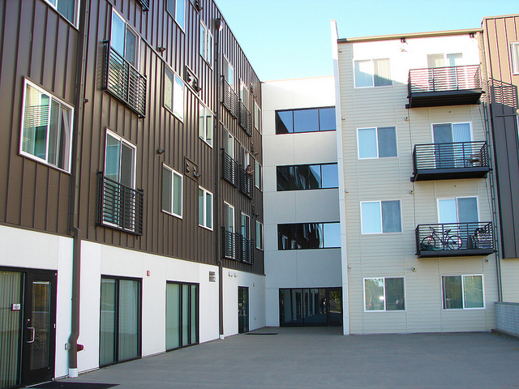
https://www.flickr.com/photos/hudopa/10821340935
https://www.flickr.com/photos/hudopa/8119096892/
Ella Encore Housing. Mixed-income housing in Florida. http://www.bizjournals.com/tampabay/news/2012/11/29/ella-nearly-ready-to-open-at-tampas.html DA: 8/6/2015
Renaissance West End Flats. Low income housing in Denver. Accompanied by the West End Health Center. http://www.westword.com/news/west-end-flats-and-health-center-bring-101-low-income-units-clinic-5871971 DA: 8/6/2015

Slide 6
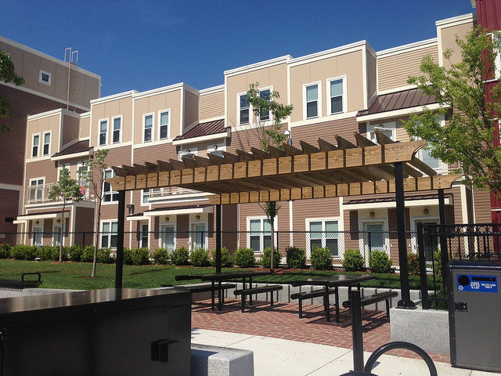
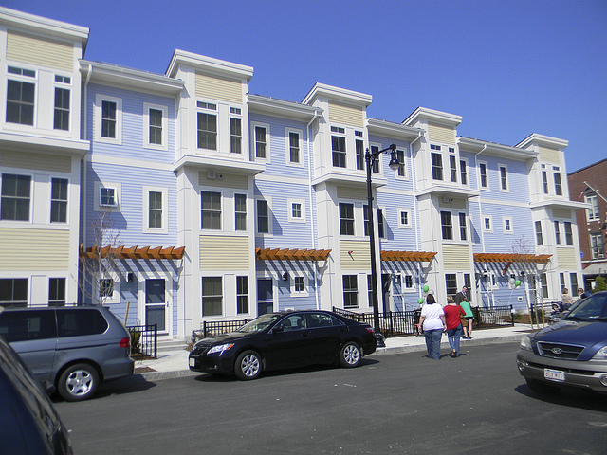
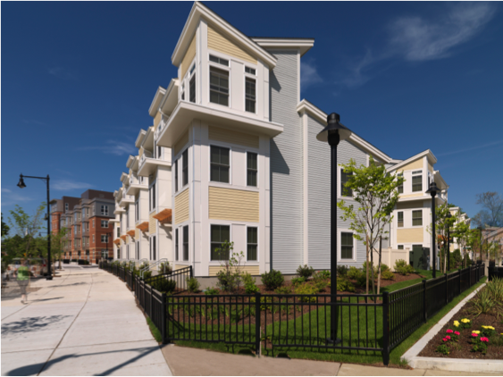
https://www.flickr.com/photos/hudopa/9240190446/
“The Homes at Old Colony is one of the largest “green” residential affordable housing project constructed in the Commonwealth.” https://www.bostonhousing.org/en/Departments/Planning-and-Real-Estate-Development/Mixed-Finance-Development/Old-Colony-Phase-One.aspx DA: 8/6/2015
Chelsea Box District, a mixed-income neighborhood. http://www.chelsearecord.com/2010/07/08/out-of-the-ashes-chelseas-box-district-the-new-up-and-coming-neighborhood/ DA: 8/6/2015

Slide 7
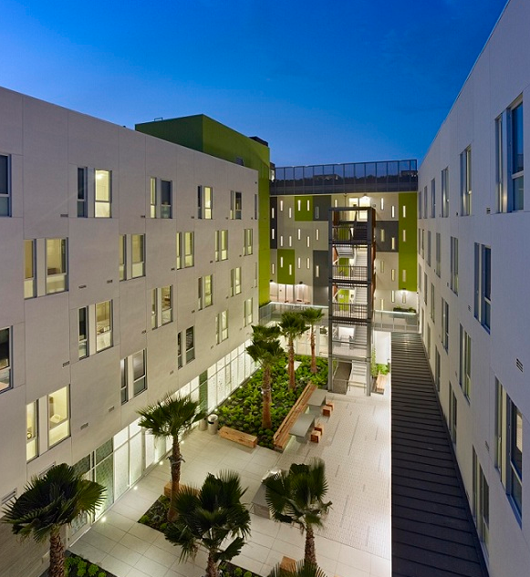
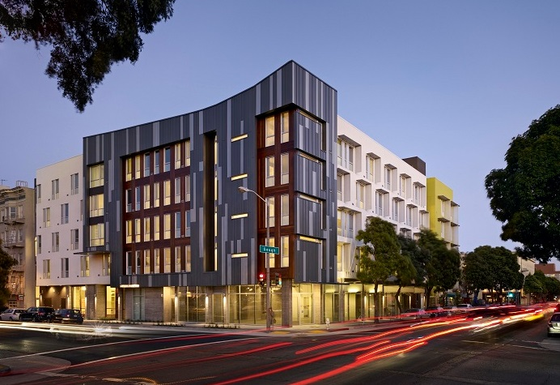
“Richardson Apartments provides 120 permanent supportive housing units to former chronically homeless San Franciscans.” http://www.huduser.org/portal/casestudies/study_08072012_1.html# DA: 8/6/2015

Slide 8
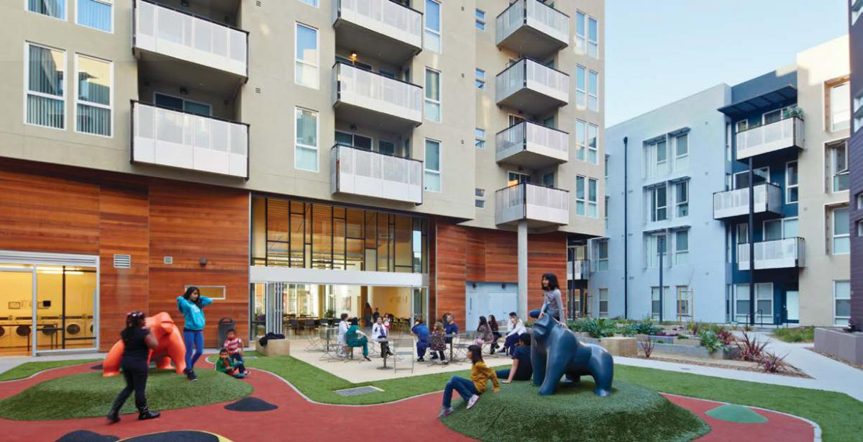

Slide 9
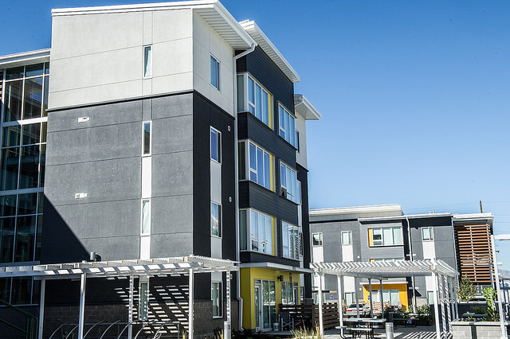
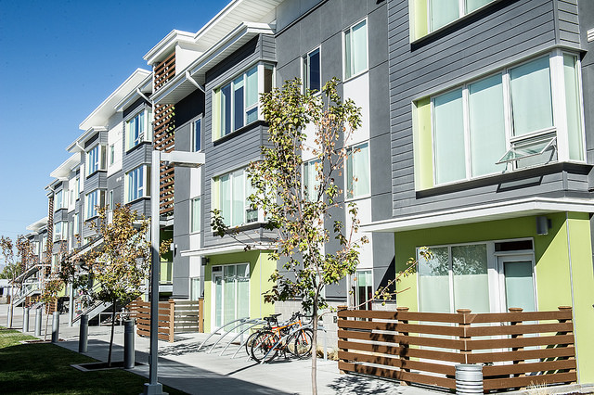
https://www.flickr.com/photos/hudopa/15345805862/
https://www.flickr.com/photos/hudopa/15342926371/
Bud Bailey Community Apartments. “The new complex provides affordable housing for refugees and other low-income members of the local community.” http://www.ksl.com/?nid=148&sid=31699602 DA: 8/6/2015

Slide 10
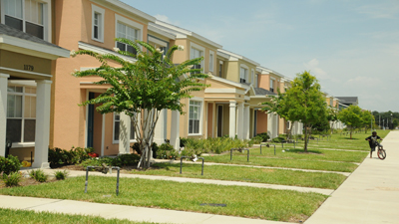
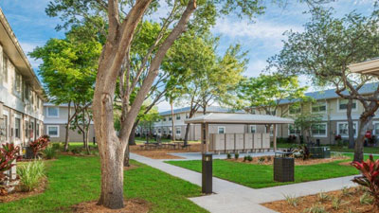
“Modernizing Affordable Housing in Orlando” http://portal.hud.gov/hudportal/HUD?src=/states/florida/library/photos DA: 8/6/2015
Rental Assistance Demonstration project in Florida. “Inviting surroundings and supportive services are included in the new chapter of the housing development.” http://portal.hud.gov/hudportal/images/hudimg?id=2015-06-15b-fl.jpg DA: 8/6/2015

Slide 11
Consequences of Expensive Housing for Some Low-Income Households

Slide 12
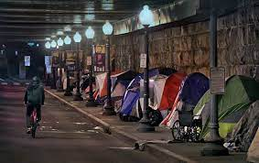
“Family Homelessness in D.C. is Growing”
https://www.washingtonpost.com/opinions/local-opinions/family-homelessness-in-dc-is-growing/2020/12/17/f74fe32e-38cc-11eb-bc68-96af0daae728_story.html

Slide 13
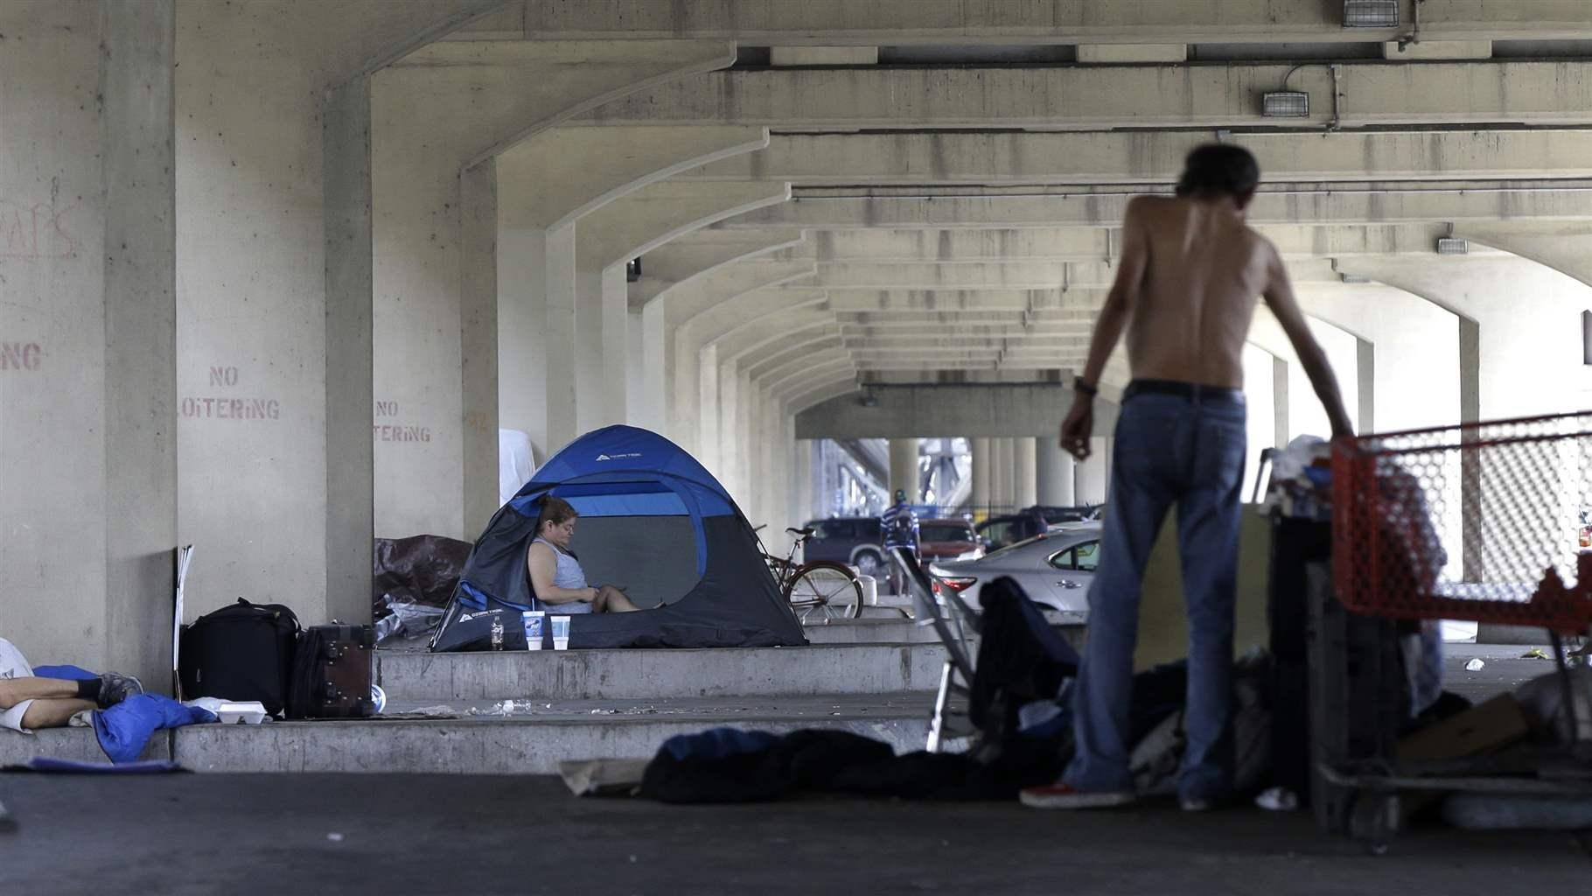
“A homeless encampment under an overpass in New Orleans”
https://www.pewtrusts.org/en/research-and-analysis/blogs/stateline/2019/10/15/what-new-orleans-can-teach-other-cities-about-reducing-homelessness

Slide 14
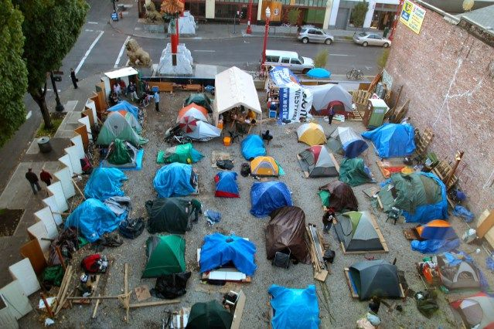
“Tent Cities are Booming”
https://truepundit.com/tent-cities-full-of-homeless-people-are-booming-in-cities-all-over-america-as-poverty-spikes/

Slide 15
“Homeless People in America”
https://efsantabarbaranews.com/2018/08/02/homeless-people-in-america-2/

Slide 16
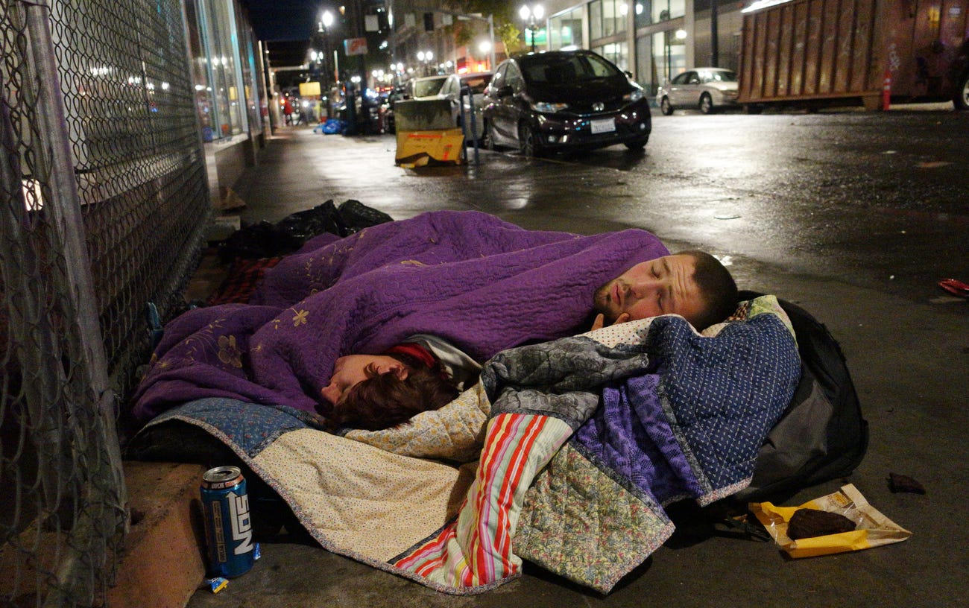
“A couple sleeps on the street in downtown Portland” https://www.businessinsider.com/photos-homelessness-states-worst-crises-2018-11

